Slide 1
TAILORED SAMPLE RECOMMENDATIONS FOR MUSIC PRODUCERS

Slide 2
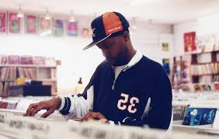
What is Sampling?
Sampling is the process of reusing portions of older songs in new ones.
Also called “crate-digging”, it can involve extensive searching to find a new sound.
The overwhelming number of options can discourage producers from searching out new possibilities.
Notes:
http://www.marsbands.com/2011/10/97-million-and-counting/
(nearly 100 million recorded songs!)

Slide 3
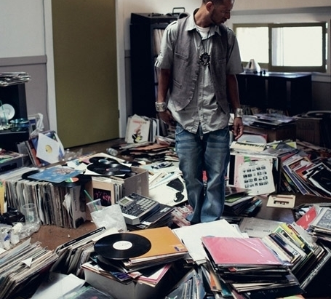
recommenders help USERS Choose From Many options
Recommendation engines are used in fields like movies or music to help users sift through their many options.
How do these algorithms create individually tailored recommendations for their users?
Notes:
https://datajobs.com/data-science-repo/Recommender-Systems-%5BNetflix%5D.pdf

Slide 4
Types of Recommendation Systems
Content Filtering
Collaborative Filtering
Gathers characteristics about users and items.
Learns about users and items through the behavior.
Explicit Feedback
Implicit Feedback
User ratings determine what items they are shown.
User behavior determines what items they are shown.

Slide 6
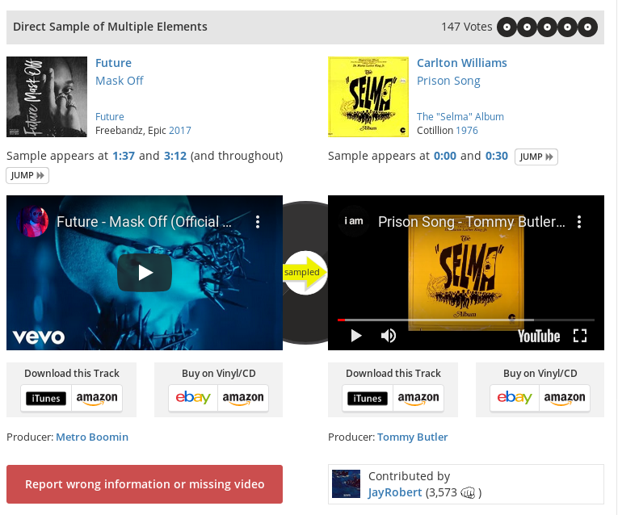
Data Collection
200,000 unique links were scraped from WhoSampled.com.
Each link represents an interaction between a producer and a sampled artist

Slide 7

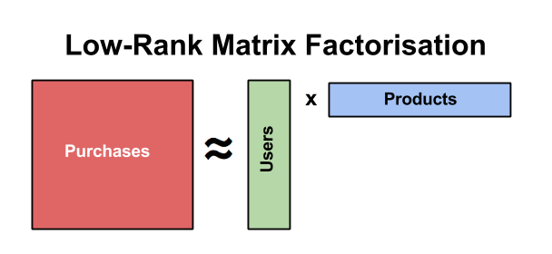
Latent Factor model
Producer-Sampled Artist Connection
Producer Matrix
Sampled Artist Matrix

Slide 8
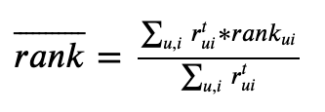
Ranking the Model
The rank score ranges from 0 to 1, with lower scores being better.
A rank score of 0.5 reflects a model no better than random.
Model performance is compared to a baseline of simply recommending the most popular artists.

Slide 9
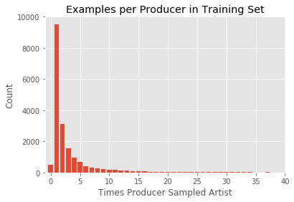
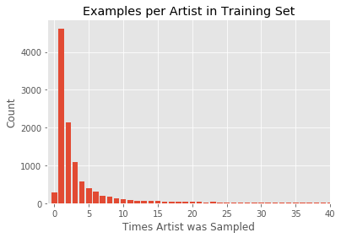
Model Performance Hampered by Sparsity of Data
Notes:
Sparsity of data means few examples to train on.

Slide 10
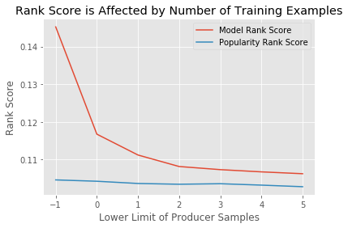
Notes:
Therefore, I limited my dataset to producers with greater than 5 examples.

Slide 11
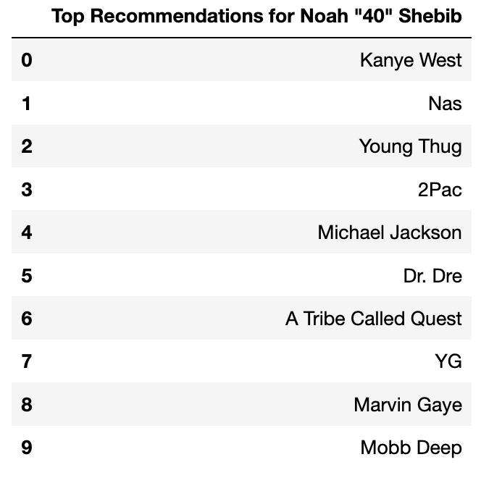
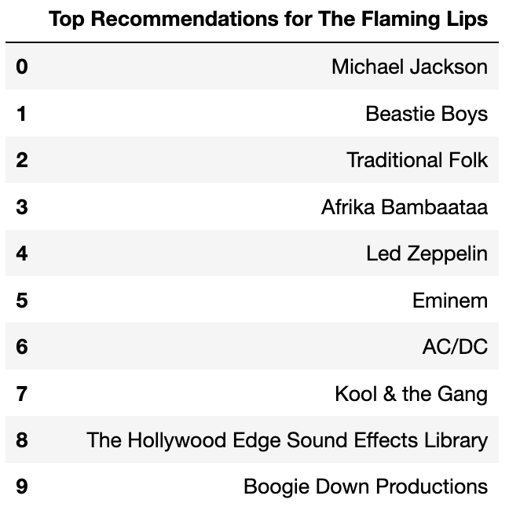
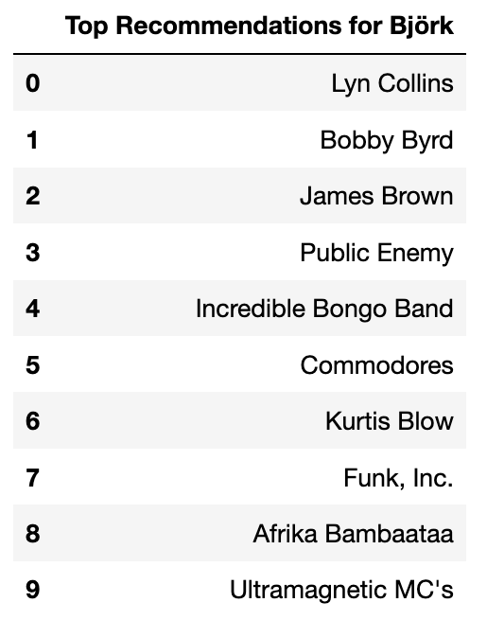
Recommendations Are Tailored BY Genre
Hip Hop
Rock
Alternative

Slide 12
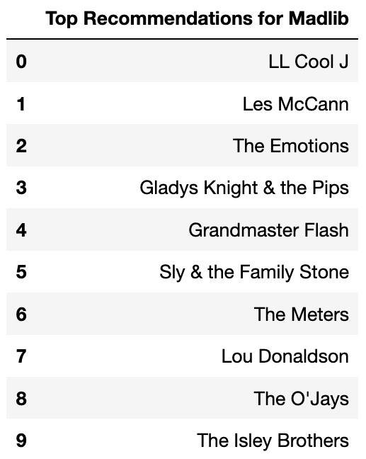
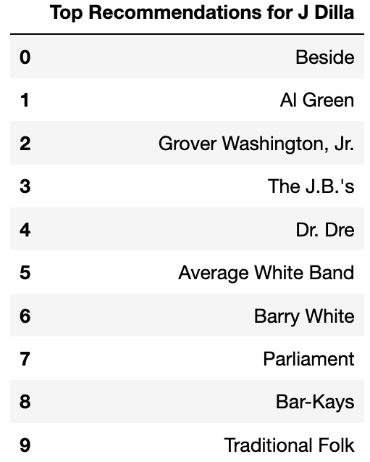
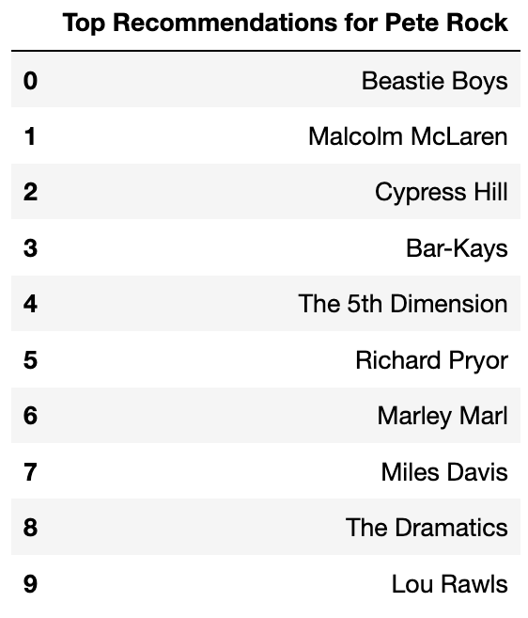
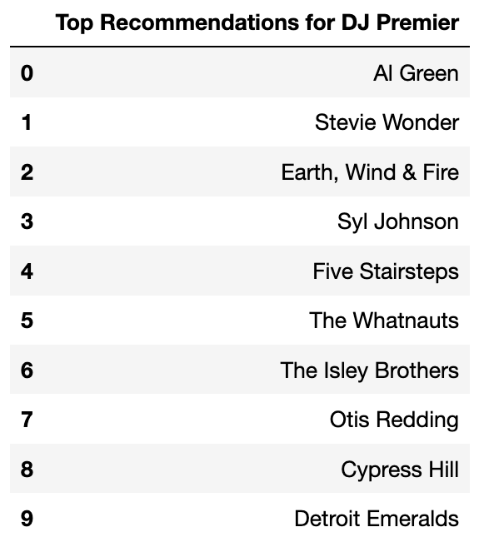
Recommendations Are better tailored FOR Producers with more samples
Notes:
These are the top 4 producers in the dataset, and we can see that their recommendations are very unique to them.

Slide 13
Conclusion and Future steps
My model scores much better than random and is similar to popularity.
However, many of its’ recommendations are lacking in diversity.
Furthermore, it is not effective for producers with few sampled artists.
A multi-level ensemble recommender with content filtering may help to address these problems.

Slide 14

Contact + Acknowledgements
Kerr.Jesse@gmail.com
https://github.com/Jesse-Kerr/recordmender
https://www.linkedin.com/in/jessekerr
Thank you to Dr. Joseph Gartner, Dan Rupp, and everyone in my Galvanize cohort.

Slide 15
Finding similar producers
His brother
His protege
Worked together

